Slide 1
MSSP 608: Practical Machine Learning Methods Week 7
1

Slide 2
House Keeping
Quiz due tomorrow (before midnight)
Quiz 5 feedback due Monday
Homework 2 is due Wednesday (3/9) at 11:59 p.m. EST
Week 7 asynchronous learning / python script to posted tomorrow
I will host office hours Friday specific to homework only
1-3 p.m. EST -- look out for Zoom link via announcement

Slide 3
Road Map…
Prior weeks
This week
Coming weeks
Validation | ML Algorithms
 | Supervised | Unsupervised | Reinforcement
 | Decision trees | Prin. Comp. Anal. (PCA)
Test/train (hold out cross validation) | Linear regression | K-means
K-fold cross-validation | Logistic regression | Hierarchical clustering
Stratified cross-validation | Random Forests (bagging)
Hyperparameter tuning (ridge, lasso, elastic net regression) | Support vector machines (SVM)
Ensemble learning | K-nearest neighbors (knn)
Bagging
Boosting

Slide 4
Quiz #4 class average – 90%
4

Slide 5
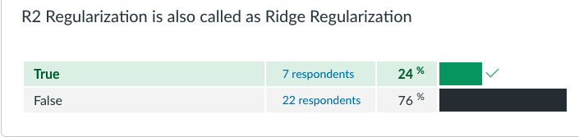
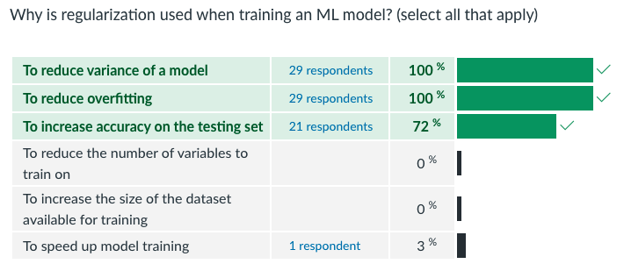
Quiz 5 (1)

Slide 6
Homework #1 class average ~ 98% with outliers (21/22 out of 24)
6

Slide 7
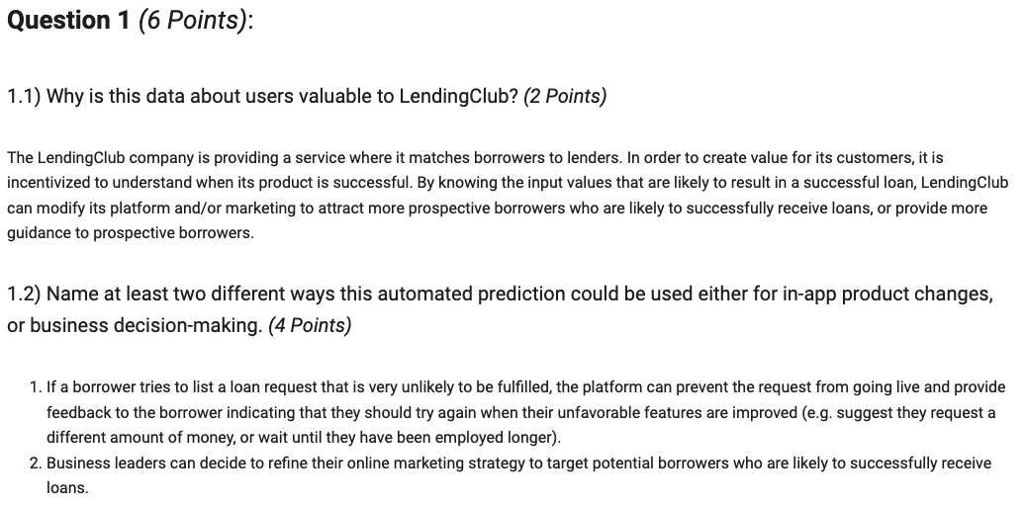
Homework 1 (1)

Slide 8
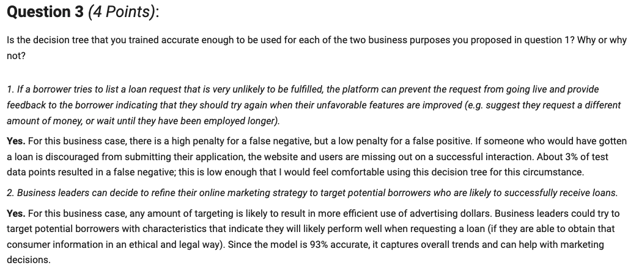
Homework 1 (2)

Slide 9
Assignment #2
9

Slide 10
Assignment 1:
Ensure your responses are answering the question. Look at Assignment 1 key (posted to Canvas) as an example.
In Question 2 of Assignment 2, you are asked to select 3 of the 5 options. For each option you select, you are asked to “include a write up.”
Please write 2-3 sentences with a thoughtful response.
There is no right answer per se – you just need to provide your response and support it by the results of your analysis.
Notes:
Ask clarifying questions
Identify the key goal of case study
Map out solution for how LendingTree can reach their goal (NOT ANALYSIS)
What analytic strategy (ML based) will reach address goal of study

Slide 11
Case Study
11

Slide 12
LendingTree:
LendingTree case study
Borrowers submit loan requests
Lenders
10,000 applications
LendingTree platform
2000 applications fulfilled (20%)
LendingTree earns a fee on successful loan requests
Success loan requests

Slide 13
Findings from Assignment 1:
Label
Accept/Reject (we had to label – 0 and 1 – 0 indicted rejected borrowers and 1 represented accepted)
4 features:
Loan amount
FICO score
DTI
Employment length
Algorithm:
Decision Tree
Test/train:
Hold out (70/30 train/test split)
Accuracy:
~94.7% accuracy
Notes:
Ask clarifying questions
Identify the key goal of case study
Map out solution for how LendingTree can reach their goal (NOT ANALYSIS)
What analytic strategy (ML based) will reach address goal of study

Slide 14
Case Study
Our client, LendingTree, thanked us for our initial analysis but are concerned that the algorithm we provided has not yet been optimized. The CEO expressed that “our initial results were a good start but we need additional analytics to ensure we have fully optimized the solution before it goes ‘live’.”
Remember steps of case study…
Clarifying questions
Identify the key goal
Map out solution (not yet the analysis)
Analysis plan
Notes:
Ask clarifying questions
Identify the key goal of case study
Map out solution for how LendingTree can reach their goal (NOT ANALYSIS)
What analytic strategy (ML based) will reach address goal of study

Slide 15
How to optimize?
What is objective ?
Map out solution?
Combinations of features (assignment 1 used all 4)
Less complex, faster, more generalizable
Decision vs. logistic regression
Lower variance – results more model accuracy on test data
Hyperparameter tuning
Number of layers; minimum number of obs for leaf/split/node
Important because…helps prevents overfitting
K-fold cross-validation – k-fold stratified cross-validation
Hold out methods may have different proportion of accept/reject in train/test split
Notes:
k-fold stratified cross validation vs. hold out (5-folds)
Decision tree vs. random forest (ensemble)
Decision tree vs. logistic regression
Compare different combinations of the 4 features
Compare different test split sizes (i.e., 0.30 vs. 0.20 vs. 0.05)
Hyperparameter tuning for decision tree
Minimum obs for node split (# of obs bf a split)
Minimum obs for leaf
Max depth of a tree
Criterion (entropy vs. gini index)

Slide 16
How to optimize?
Map out solution?
k-fold stratified cross validation vs. hold out (5-folds)
Decision tree vs. random forest (ensemble)
Decision tree vs. logistic regression
Compare different combinations of the 4 features
Compare different test split sizes (i.e., 0.30 vs. 0.20 vs. 0.05)
Hyperparameter tuning for decision tree
Minimum obs for node split (# of obs bf a split)
Minimum obs for leaf
Max depth of a tree
Criterion (entropy vs. gini index)
Notes:
k-fold stratified cross validation vs. hold out (5-folds)
The solution is optimized via k-fold stratified cross validation because it ensures balance in the train/test sets for the proportion of accepted applications whereas the hold method does not. Our result confirm this because our accuracy increased to 96%.
Decision tree vs. random forest (ensemble)
Decision tree vs. logistic regression
This solution could be optimized because decisions are subject to overfitting and thus are less generalizable whereas logistic regression is a high bias/low variance algorithm and thus are more generalizable and possibly resulting in increased accuracy. Our results do not confirm our initial hypotheses as results yielded a 90% accuracy.
Compare different combinations of the 4 features
This solution could be optimized by creating a more parsimonious model – i.e., this is a less complex model, less likely to be overfitted, and thus more generalizable.

Slide 17
Review (last week)
17

Slide 18
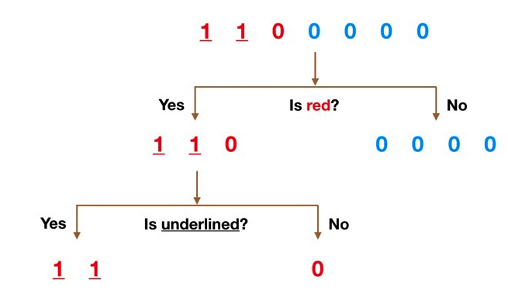
What/Why ensembles?
Individual Algorithms:
Sensitive to the training data
Poor generalizability
Prone to overfitting
“weak” learners
Ensemble learning combines two or more models to build a more accurate model
“strong” learners
More generalizable; less sensitive to training data; less prone to overfitting

Slide 19
Review:
Ensemble Learners
Multiple ML models are combined to build a more robust and accurate model
Produces better accuracy by average the results from all of ML models
More generalizable than any of the individual learners
Boosting and bagging are two approaches used in ensemble learning
Types of ensemble learners – they are not algorithms
Random Forest (bagging = bootstrap + aggregation)
Collection of Decision Trees
Goal is to reduce variance
Each tree contains a random subset of both data AND features
Continuous outcomes = take the average value
binary outcome = most frequent outcome value

Slide 20
Bagging vs. Boosting
Bagging
Data partition is random
Goal is to reduce the variance in model
Each model is independent
Boosting
Misclassified data is given higher importance (more likely to be selected for the next iteration)
Goal is to increase prediction accuracy of model
Training of model for current step depends on prior step

Slide 21
This week
21

Slide 22
Concepts:
K-nearest neighbors (KNN)
Support vector machines (SVM)

Slide 23
K-nearest neighbors
23

Slide 24
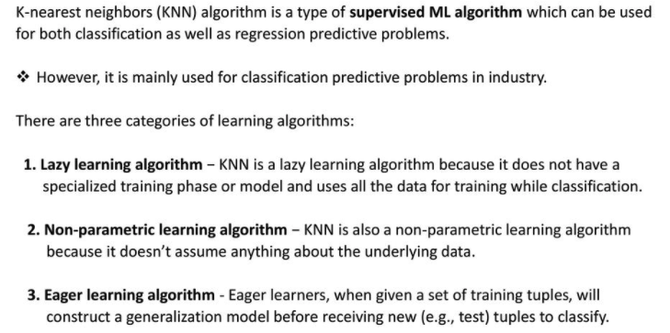
Introduction:

Slide 25
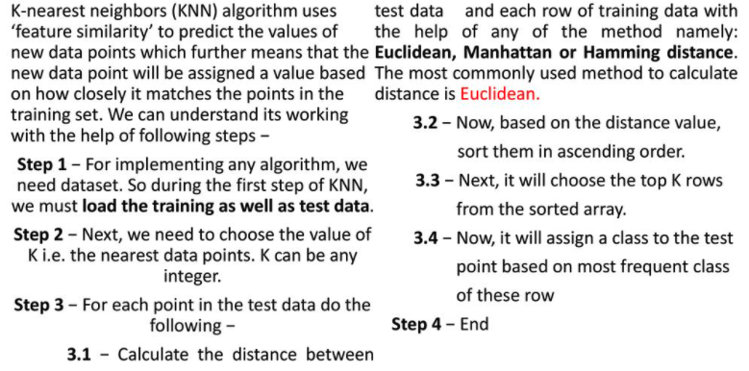
KNN Algorithm:

Slide 26
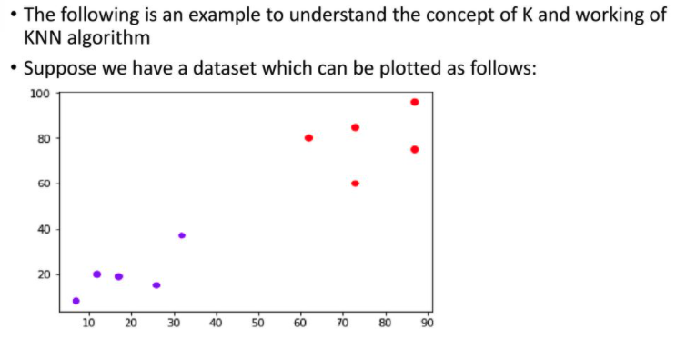
Example (1):

Slide 27
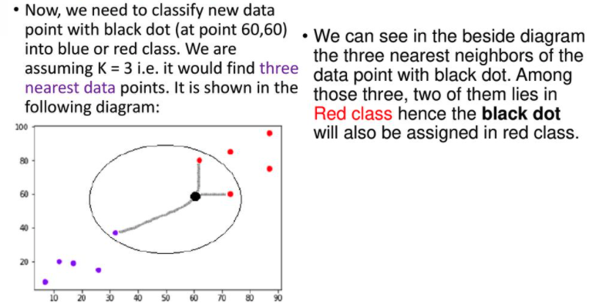
Example (2):

Slide 28
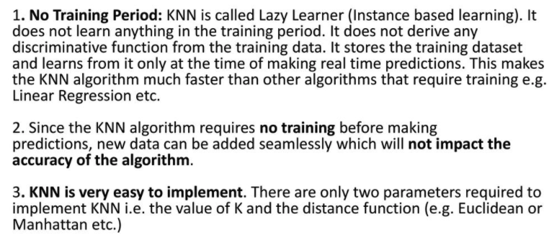
Advantages:

Slide 29
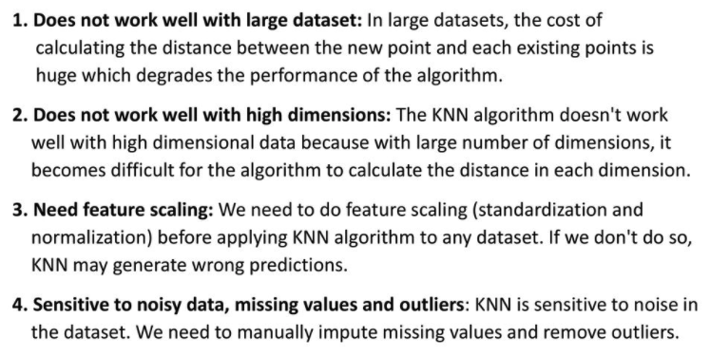
Disadvantages:

Slide 30
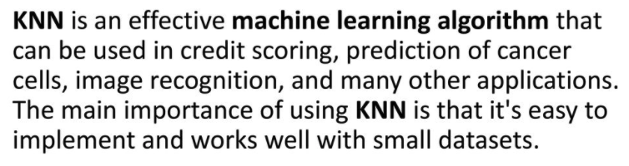
Conclusion:

Slide 31
Support Vector Machines
31

Slide 32
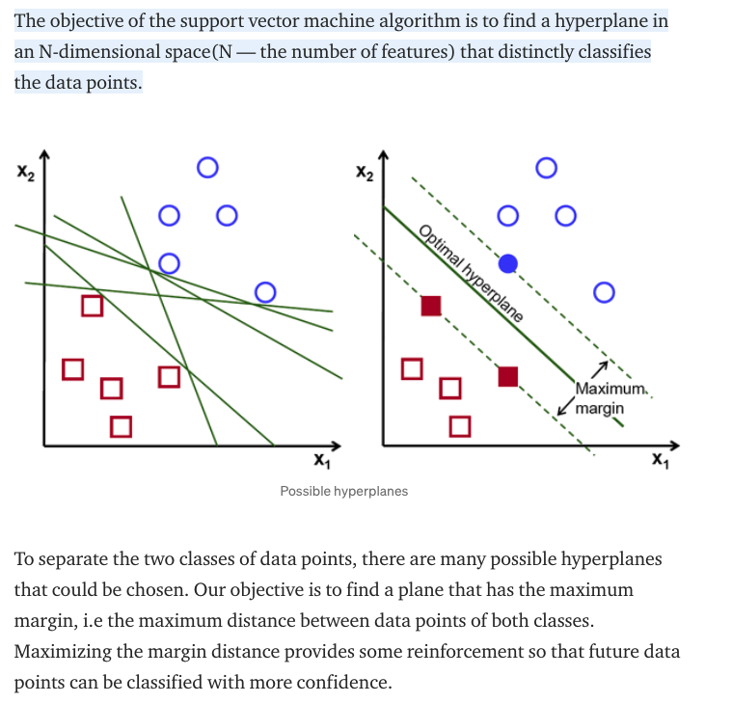
What is Support Vector Machine?

Slide 33
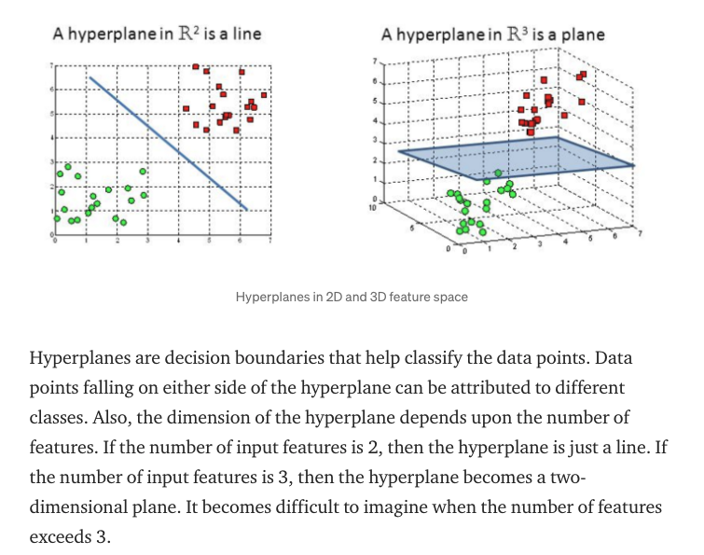
What is a hyperplane?

Slide 34
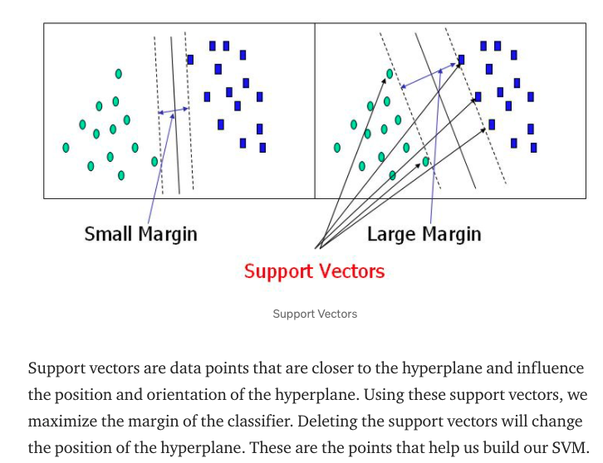
What is a margin?

Slide 35
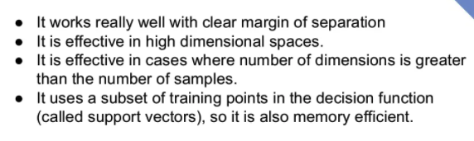
Advantages:

Slide 36
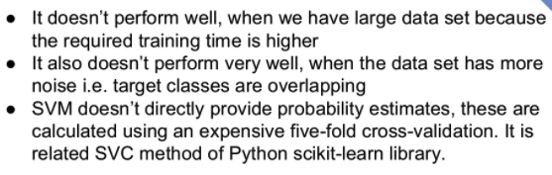
Disadvantages:

Slide 37
Disadvantages:
Bagging 1 2 3 4 5
Cross-valid (4-fold)
75/25
75/25
75/25
75/25

